Slide 1
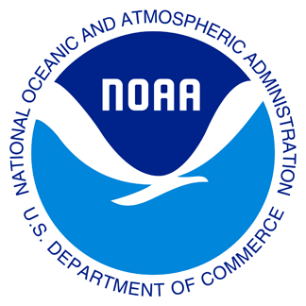

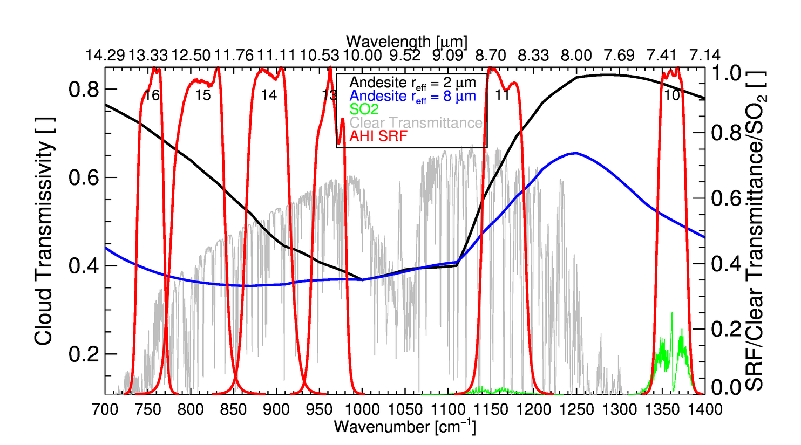
Future GOES-R Capability: SO₂ Detection
Mike Pavolonis (NOAA/NESDIS/STAR)
The GOES-R ABI has channels (7.3 and 8.5 um) that encompass SO₂ absorption lines. Thus, quantitative SO₂ detection and characterization is possible with GOES-R. This project is aimed at developing quantitative SO₂ products for GOES-R (SO₂ probability, loading, and height) that will be integrated into NOAA’s Volcanic Cloud Analysis Toolkit (VOLCAT).
The general algorithm concepts developed for volcanic ash (Pavolonis, 2010; Pavolonis et al., 2013; Pavolonis 2015a, 2015b) are being adapted for SO₂.
Infrared SO₂ absorption lines (green) are shown relative to certain ABI spectral response functions (red) and other infrared attenuating atmospheric species (H₂O+ O₃ and volcanic ash)

